Slide 1
Statistical data analysis in R
Visiting professor
Viktor Ermakov

Slide 2
Lecture 10

Slide 3
Fitting distributions

Slide 4
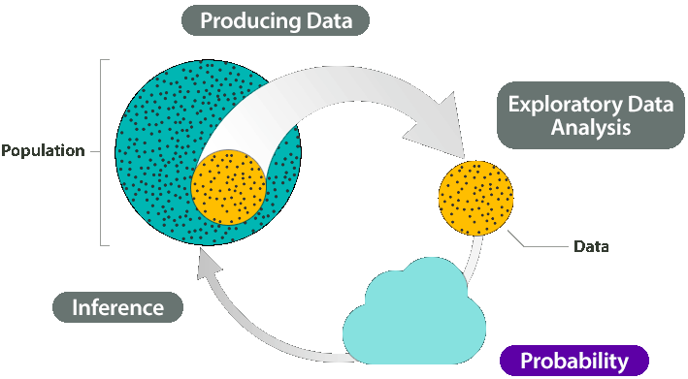
In this lecture
Statement of the problem
Techniques of distribution fitting
Maximum likelihood estimation
Maximum moment matching
Quantile matching estimation
Maximum goodness-of-fit estimation
Statistical data analysis in R. Viktor Ermakov – Visiting professor, UFSCar.

Slide 5
Statement of the problem
# A tibble: 908 x 1
Tratio
<dbl>
1 2.67
2 3.67
3 3.5
4 5.25
5 7
6 7
7 4.4
8 3.67
9 3.43
10 2.67
# … with 898 more rows
Experimental data x₁, x₂, …, x_{n}
assumed to be observations of a random variable X that has a distribution with a probability density function f_{X}(x)
Statistical data analysis in R. Viktor Ermakov – Visiting professor, UFSCar.

Slide 6
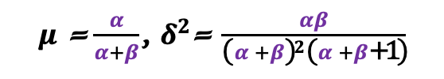

Statement of the problem
# A tibble: 908 x 1
Tratio
<dbl>
1 2.67
2 3.67
3 3.5
4 5.25
5 7
6 7
7 4.4
8 3.67
9 3.43
10 2.67
# … with 898 more rows
The goal of the fitting is to estimate:
which distribution better describes the experimental data
unknown parameters of the distribution
parameters of interest (mean, mode, median, variance, quantiles, survival probabilities, etc.)
LogNormal(𝜇, 𝜎)
Normal
(𝜇, 𝜎)
⇒
𝜇 = 𝜇, 𝛿² = 𝛿²
$μ$ =$\frac{α}{λ}$, $δ^{2}$= $\frac{α}{{\text{λ}}^{2}}$
Gamma
(𝜆, 𝛼)
⇒
(𝛼, 𝛽)
$μ$ =$\frac{α}{α+β}$, $δ^{2}$= $\frac{αβ}{{\text{(}α+β\text{)}}^{2}\text{(}α+β\text{+1}\text{)}}$
Beta
⇒
Statistical data analysis in R. Viktor Ermakov – Visiting professor, UFSCar.

Slide 7
Statement of the problem
Assumptions:
all the observations are identically distributed
observations are independent
LogNormal(𝜇, 𝜎)
⟱
Normal
(𝜇, 𝜎)
⇒
𝜇 = 𝜇, 𝛿² = 𝛿²
$μ$ =$\frac{α}{λ}$, $δ^{2}$= $\frac{α}{{\text{λ}}^{2}}$
Gamma
(𝜆, 𝛼)
⇒
i.i.ds
(𝛼, 𝛽)
$μ$ =$\frac{α}{α+β}$, $δ^{2}$= $\frac{αβ}{{\text{(}α+β\text{)}}^{2}\text{(}α+β\text{+1}\text{)}}$
Beta
⇒
Statistical data analysis in R. Viktor Ermakov – Visiting professor, UFSCar.

Slide 8
Techniques of distribution fittings
Parametric methods
parameters of distribution (𝜇, 𝛿, 𝛼, 𝛽, 𝜆) are calculated from the data series
Maximum likelihood method (maximum likelihood estimation or mle)
Maximum spacing estimation
Method of L-moments
Quantile matching estimation or qme
Method of moments (moment matching estimation or mme)
Maximum goodness-of-fit estimation or mge
Statistical data analysis in R. Viktor Ermakov – Visiting professor, UFSCar.

Slide 9
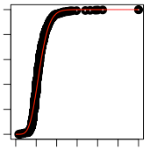
Techniques of distribution fittings
Regression method
experimental data are arranged by ascending order
transformed into an experimental CDF
linear relation is found between experimental and theoretical CDFs
# A tibble: 908 x 1
Tratio
<dbl>
1 2.67
2 3.67
3 3.5
4 5.25
5 7
6 7
7 4.4
8 3.67
9 3.43
10 2.67
# … with 898 more rows
# A tibble: 908 x 1
Tratio
<dbl>
1 1.14
2 1.2
3 1.2
4 1.22
5 1.31
6 1.35
7 1.38
8 1.38
9 1.41
10 1.43
# … with 898 more rows
Statistical data analysis in R. Viktor Ermakov – Visiting professor, UFSCar.

Slide 10
Maximum likelihood estimation
Experimental data x₁, x₂, …, x_{n}
assumed to be observations of a random variable X that has a distribution with a probability density function f_{X}(x)
2
1
0
1
2
1
1
0
x
x₄
x₅
x₁
x₃
x₂
Statistical data analysis in R. Viktor Ermakov – Visiting professor, UFSCar.

Slide 11
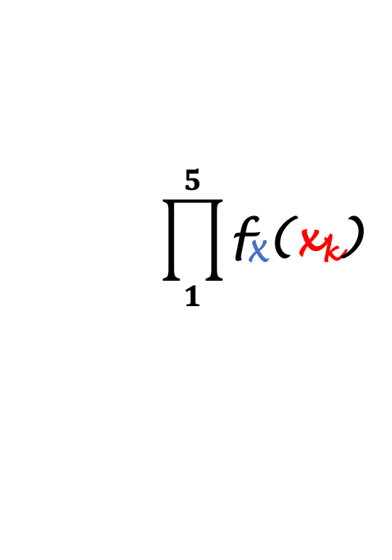
Maximum likelihood estimation
f_{X}(x)
Experimental data x₁, x₂, …, x_{n}
assumed to be observations of a random variable X that has a distribution with a probability density function f_{X}(x)
f_{X}(x₁)
f_{X}(x₃)
f_{X}(x₅)
f_{X}(x₂)
f_{X}(x₄)
x
x₄
x₅
x₁
x₃
x₂
$$\prod_{1}^{5}{\text{f}\text{X}\text{(}\text{x}\text{k}\text{)} }$$
Likelihood
f_{X}(x₁)⋅f_{X}(x₂)⋅f_{X}(x₃)⋅f_{X}(x₄)⋅f_{X}(x₅)
Probability
f_{X}(x₁)
⇒
Statistical data analysis in R. Viktor Ermakov – Visiting professor, UFSCar.

Slide 12
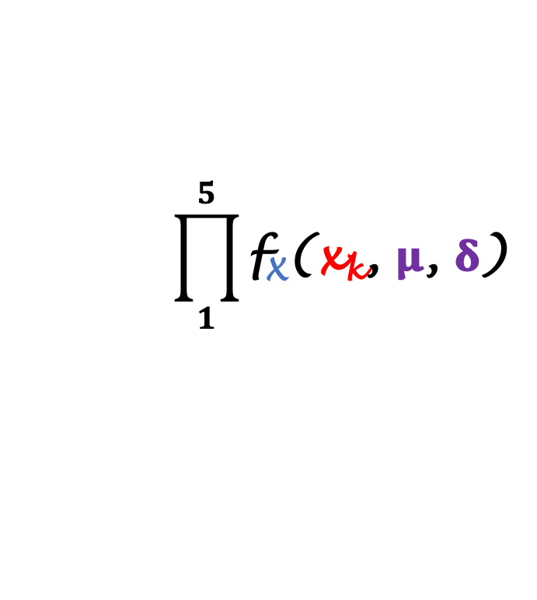

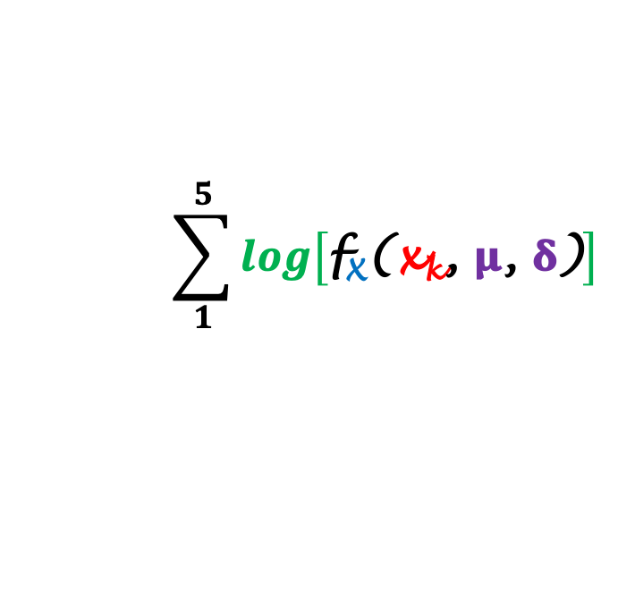
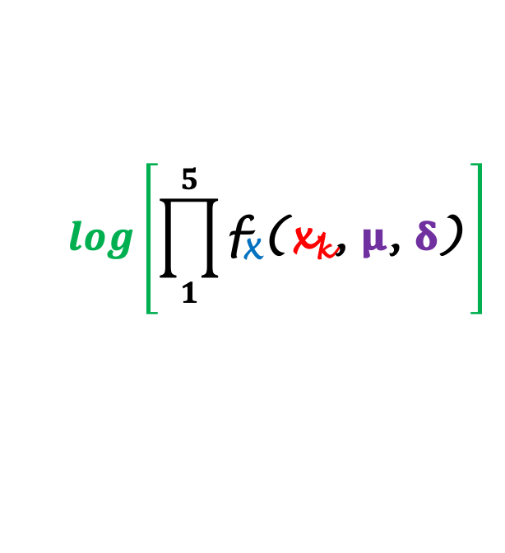
Maximum likelihood estimation
f_{X}(x)
Experimental data x₁, x₂, …, x_{n}
assumed to be observations of a random variable X that has a distribution with a probability density function f_{X}(x)
f_{X}(x, 𝛍, 𝛅)
f_{X}(x₁)
𝛅
𝛅
f_{X}(x₃)
f_{X}(x₅)
f_{X}(x₂)
f_{X}(x₄)
x
x₄
x₅
x₁
𝛍
x₃
x₂
$$\prod_{1}^{5}{\text{f}\text{X}\text{(}\text{x}\text{k}\text{,} \text{μ}\text{,} \text{δ}\text{)} }$$
$$\prod_{1}^{5}{\text{f}\text{X}\text{(}\text{x}\text{k}\text{)} }$$
Maximize
⇒
Likelihood
𝚹(x₁,…,x_{k}, 𝛍, 𝛅)
=
extract 𝛍, 𝛅
𝚹(x₁,…,x_{k}, 𝛍, 𝛅)
LogLikelihood
⇒
$$log\left[\prod_{1}^{5}{\text{f}\text{X}\text{(}\text{x}\text{k}\text{, }\text{μ}\text{, }\text{δ}\text{)} }\right]$$
$$\sum_{1}^{5}{log\left[\text{f}\text{X}\text{(}\text{x}\text{k}\text{, }\text{μ}\text{, }\text{δ}\text{)}\right]}$$
log[
]
=
Statistical data analysis in R. Viktor Ermakov – Visiting professor, UFSCar.

Slide 13
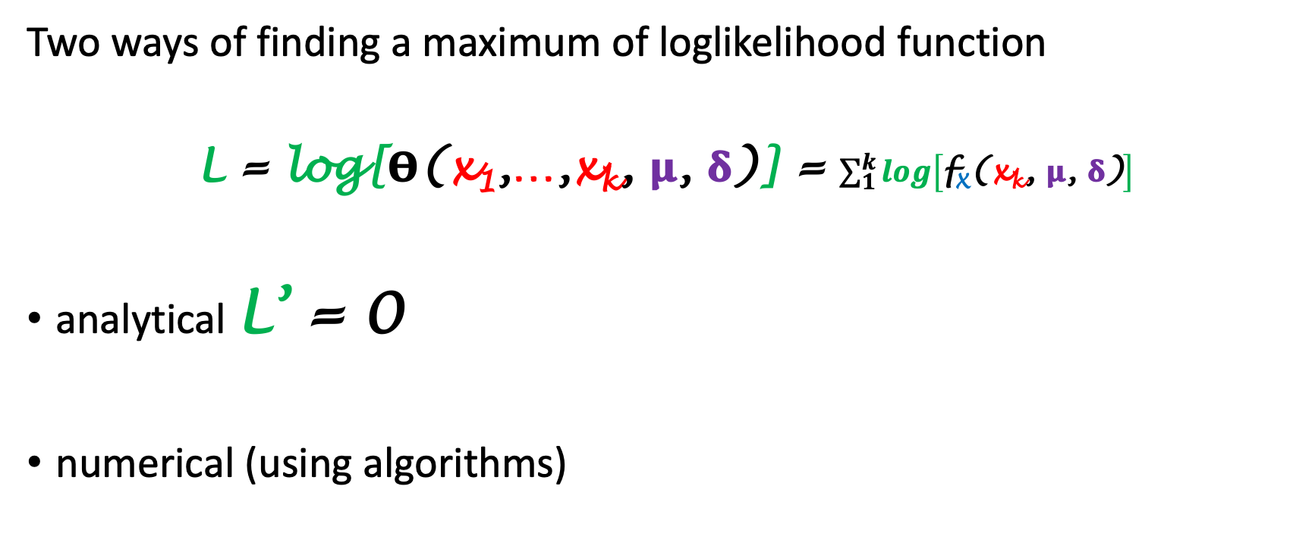
Maximum likelihood estimation
Two ways of finding a maximum of loglikelihood function
L = log[𝚹(x₁,…,x_{k}, 𝛍, 𝛅)] = $\sum_{1}^{k}{log\left[\text{f}\text{X}\text{(}\text{x}\text{k}\text{, }\text{μ}\text{, }\text{δ}\text{)}\right]}$
analytical L’ = 0
numerical (using algorithms)
Statistical data analysis in R. Viktor Ermakov – Visiting professor, UFSCar.

Slide 14
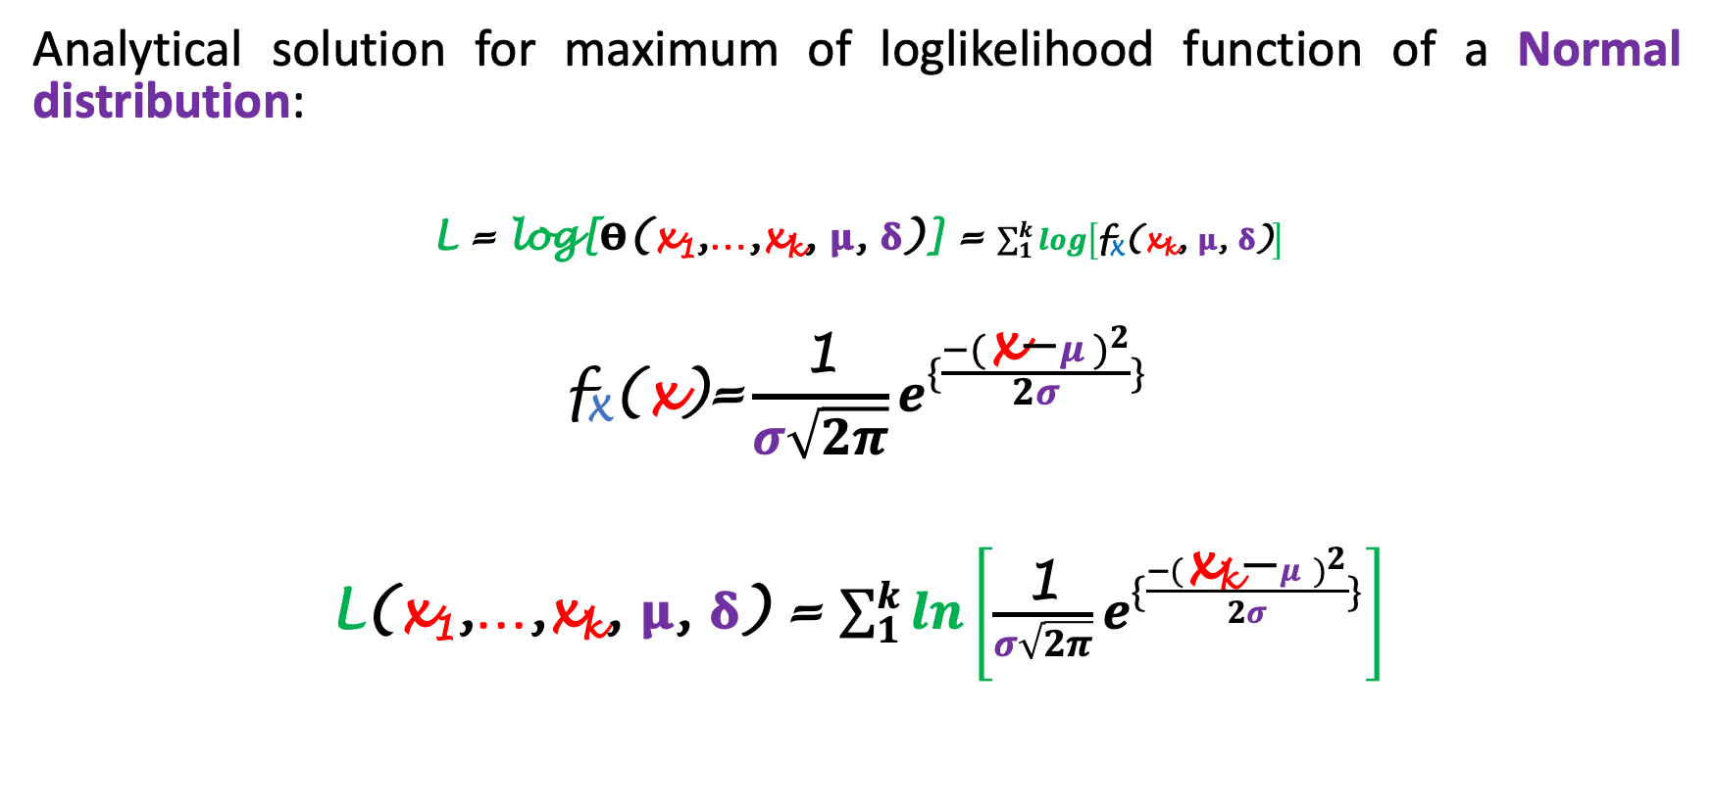
Maximum likelihood estimation
Analytical solution for maximum of loglikelihood function of a Normal distribution:
L = log[𝚹(x₁,…,x_{k}, 𝛍, 𝛅)] = $\sum_{1}^{k}{log\left[\text{f}\text{X}\text{(}\text{x}\text{k}\text{, }\text{μ}\text{, }\text{δ}\text{)}\right]}$
$$\text{f}\text{X}\text{(}\text{x}\text{)}\text{=}\frac{\text{1}}{σ\sqrt{2π}}e^{\{\frac{−{(\text{x}\text{−}μ)}^{2}}{2σ}\}}$$
L(x₁,…,x_{k}, 𝛍, 𝛅) = $\sum_{1}^{k}{ln\left[\frac{\text{1}}{σ\sqrt{2π}}e^{\{\frac{−{(\text{x}\text{k}\text{−}μ)}^{2}}{2σ}\}}\right]}$
Statistical data analysis in R. Viktor Ermakov – Visiting professor, UFSCar.

Slide 15
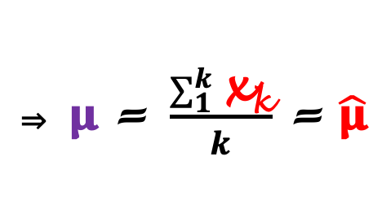
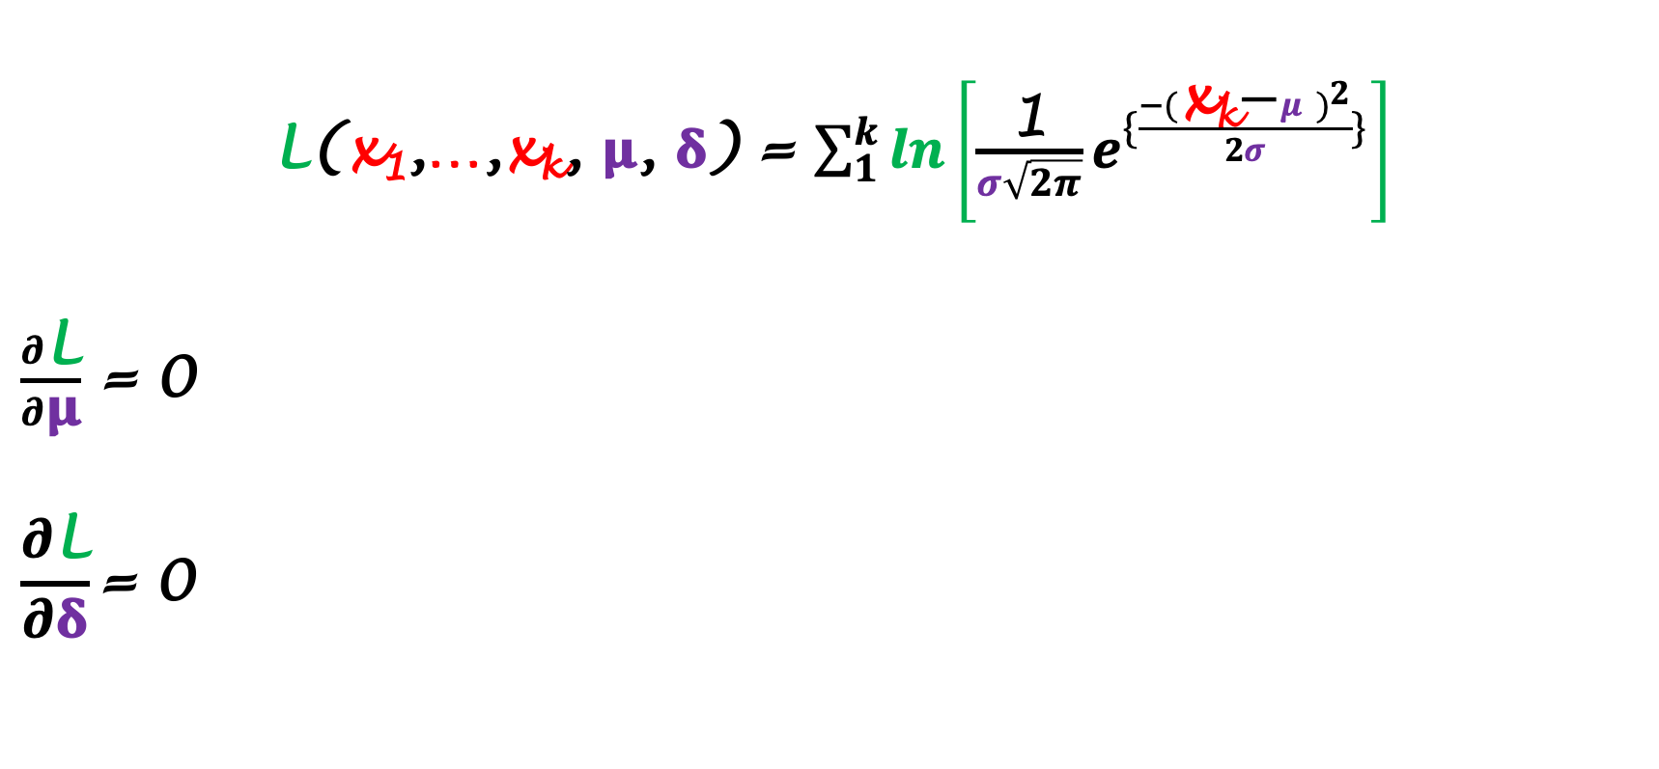
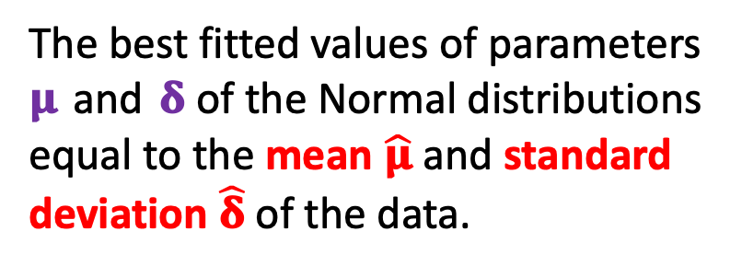
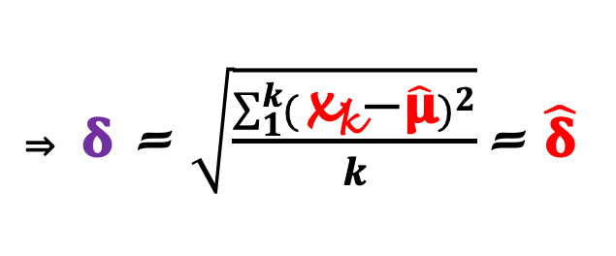
Maximum likelihood estimation
L(x₁,…,x_{k}, 𝛍, 𝛅) = $\sum_{1}^{k}{ln\left[\frac{\text{1}}{σ\sqrt{2π}}e^{\{\frac{−{(\text{x}\text{k}\text{−}μ)}^{2}}{2σ}\}}\right]}$
$\frac{∂\text{L}}{∂\text{μ}}$ = 0
$$\frac{∂\text{L}}{∂\text{δ}}\text{= 0}$$
⇒ $\text{μ} \text{= }\frac{\sum_{1}^{k}{\text{x}\text{k}}}{k} \text{= }\hat{\text{μ}}$
The best fitted values of parameters 𝛍 and 𝛅 of the Normal distributions equal to the mean $\hat{\text{μ}}$ and standard deviation $\hat{\text{δ}}$of the data.
⇒ $\text{δ} \text{= }\sqrt{\frac{\sum_{1}^{k}{({\text{x}\text{k}\text{−}\hat{\text{μ}})}^{2}}}{k}}\text{=} \hat{\text{δ}}$
Statistical data analysis in R. Viktor Ermakov – Visiting professor, UFSCar.

Slide 16
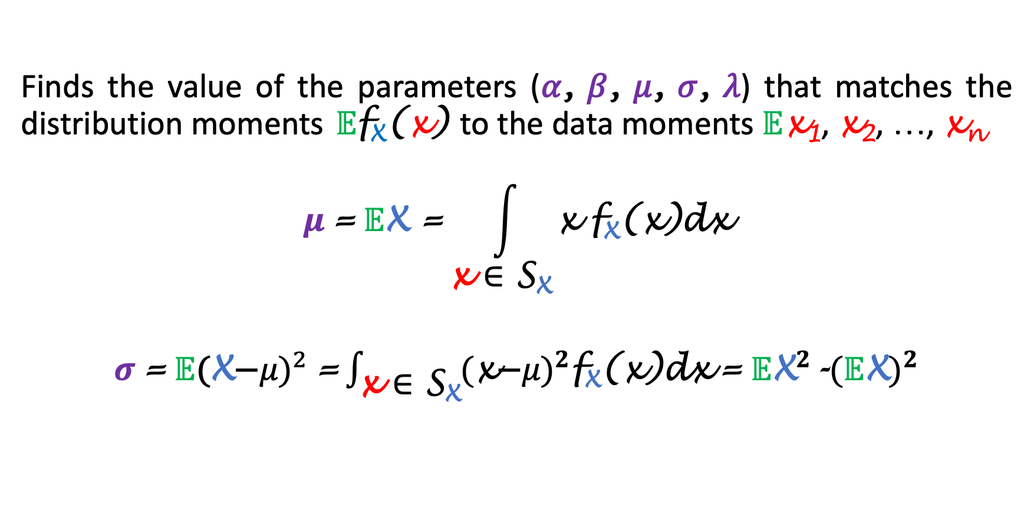
Moment matching estimation
Finds the value of the parameters (𝛼, 𝛽, 𝜇, 𝜎, 𝜆) that matches the distribution moments $𝔼$f_{X}(x) to the data moments $𝔼$x₁, x₂, …, x_{n}
$$μ \text{=} 𝔼\text{X}\text{ =}\int_{\text{x} \text{∈ }\text{S}\text{X}}{\text{x} \text{f}\text{X}\text{(}\text{x}\text{)}\text{dx}}$$
$σ \text{=} 𝔼{\text{(}\text{X}\text{−}μ\text{)}}^{2} \text{=}\int_{\text{x} \text{∈ }\text{S}\text{X}}{{\text{(}\text{x}\text{−}μ\text{)}}^{2}\text{f}\text{X}\text{(}\text{x}\text{)}\text{dx}}$ $\text{=}$ $𝔼{\text{X}}^{2}\text{-}{(𝔼\text{X})}^{2}$
Statistical data analysis in R. Viktor Ermakov – Visiting professor, UFSCar.

Slide 17
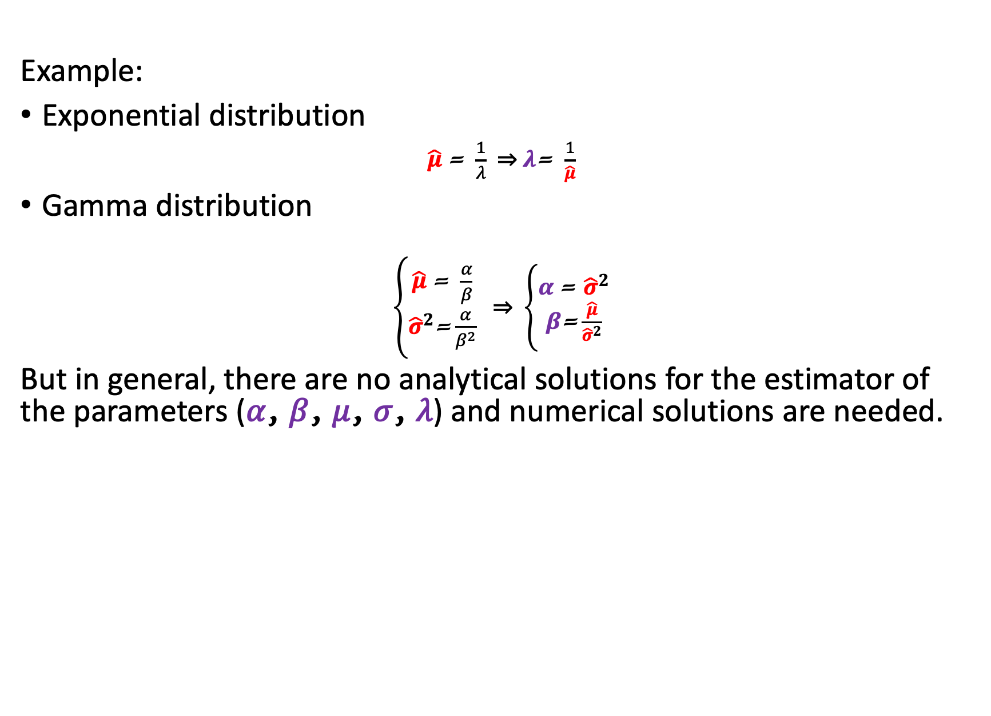
Moment matching estimation
Example:
Exponential distribution
$\hat{μ} \text{=} \frac{1}{λ}$ ⇒ $λ\text{= }\frac{1}{\hat{μ}}$
Gamma distribution
$\left\{\begin{aligned}\hat{μ} \text{=} \frac{α}{β} \\ {\hat{σ}}^{2}\text{=}\frac{α}{β^{2}}\end{aligned}\right.$ ⇒ $\left\{\begin{aligned}α \text{=} {\hat{σ}}^{2} \\ β\text{=}\frac{\hat{μ}}{{\hat{σ}}^{2}}\end{aligned}\right.$
But in general, there are no analytical solutions for the estimator of the parameters (𝛼, 𝛽, 𝜇, 𝜎, 𝜆) and numerical solutions are needed.
Statistical data analysis in R. Viktor Ermakov – Visiting professor, UFSCar.

Slide 18
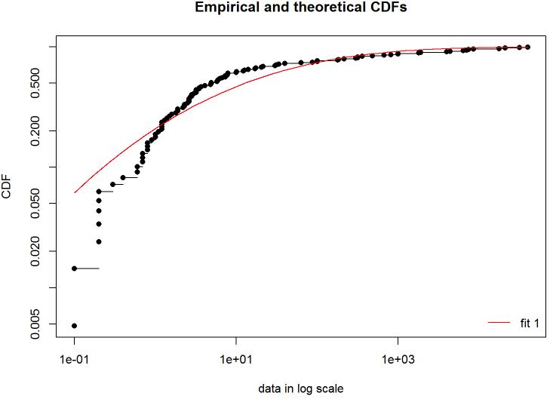
Quantile matching estimation
Finding a parameters of theoretical distribution (𝛼, 𝛽, 𝜇, 𝜎, 𝜆) such that a quantiles of experimental data match with quantiles of theoretical
only numerical solutions exist
values of percentiles has to be provided
75 percentile
25 percentile
Statistical data analysis in R. Viktor Ermakov – Visiting professor, UFSCar.

Slide 19
Maximum goodness-of-fit estimation
f_{X}(x)
Numerical estimation of parameters of theoretical distribution (𝛼, 𝛽, 𝜇, 𝜎, 𝜆) with purpose to minimize distances between theoretical and experimental values.
Kolmogorov-Smirnov KS
Anderson-Darling AD
Cramer-von Mises CvM
x
x₄
x₅
x₁
x₃
x₂
Statistical data analysis in R. Viktor Ermakov – Visiting professor, UFSCar.

